Slide 1
Generators: Deferred Evaluation in XPath

Slide 2
The Problem
[ member₁, member₂, member₃, …, member₁₀₀₀₀₀₀, …, ]
Astronomical data: 100 – 400 Billion stars
(1 to $N), $N > P₁₀₀₀₀₀₀
Issues:
How much Memory ?
Exit the traversal early when processing done?
If infinite members, can we specify/use a shortcut?

Slide 3
The Problem - 2
Not addressed by the XPath standard
Limited, if any solutions
Vendor-dependent, not portable, vendor lock-in…
Incomplete
Need a solution:
Implementation-independent
Puts the XPath programmer in full control

Slide 4
The Solution
Concept of Generators (per Wikipedia) :
Similar to function(…) as array(*)
But…
Returns one value at a time
Less memory engaged
The caller can start processing the first values immediately
Looks like a function, behaves like an iterator

Slide 5

The Generator record
Procedural Languages | XPath: declarative
Variable change. | Variables are immutable
One generator, many states | One instance, one state
declare namespace f = "http://www.w3.org/2005/xpath-functions-2025";
declare record f:generator
( initialized as xs:boolean,
end-reached as xs:boolean,
get-current as fn($this as f:generator) as item()*,
move-next as fn($this as f:generator) as f:generator,
state as map(*)
);

Slide 6
Definitions
Empty generator: $gen?end-reached eq true()
Yield:
G1
G2
G3
Gn
V1
V2
V3
Vn
G1
G2
G3
Gn
V1
V2
V3
Vn
Empty yield: $G1?end-reached eq true()
Infinite generator: Whose yield is infinite

Slide 7
Example
Yield: the names of the first leaf element and its ancestors:
let $genLeafAndAncestorNames :=
f:generator(initialized := true(),
end-reached := false(),
get-current := fn($this as f:generator)
{ let $current := $this?state?currentNode
return
if($current instance of document-node()) then '/'
else $current/name()
},
move-next := fn($this as f:generator)
{ if(empty($this?state?currentNode/..))
then map:put($this, "end-reached", true())
else map:put($this, "state",
map{"currentNode": $this?state?currentNode/..}) },
state := map{"currentNode" : (parse-xml( '<x> <y> <z/> </y> </x>')
//*[not(*)] )
[1] }
<x>
<y>
<z/>
</y>
</x>
Yield: “z”, “y”, “x”, “/”

Slide 8
Example-2
Yield: the Fibonacci sequence:
$genFibo := f:generator(initialized := true(), end-reached := false(),
get-current := fn($this as f:generator) {$this?state?current},
move-next := fn($this as f:generator)
{map:put($this, "state", map{"current": $this?state?next, "next": $this?state?current + $this?state?next} )},
state := map{"current": 0, "next": 1}
)
Yield: 0, 1, 1, 2, 3, 5, 8, 13, 21, 34, 55, 89, 144, …

Slide 9

Functions on Generators
Namespace: Q{http://www.w3.org/2005/xpath-functions/generator}
Categories : Functions producing a:
value: item() or a (s, e, q, u, e, n, c, e, …)
generator: $gen1 $gen2
generator from data provider: $gen
Materialized yield
$gen3
$gen4
Deferred Evaluation: Never need/use/materialize the complete yield

Slide 10
Functions producing a value: item() or (…)
Function | Produces
gn:at | The $k-th value from the yield of the $generator
gn:contains | true() if the $value is contained in the yield of the generator, and false() otherwise.
gn:first-where | The first $value in the yield of the generator for which $predicate($value) is true(). Error if none.
gn:fold-left | Processes the values of the yield of the generator, applying the supplied function repeatedly to each value in turn, together with an accumulated result value.
gn:fold-right | Like gn:fold-left but from right to left.
gn:fold-lazy | Same result as gn:fold-right on the entire yield of the $generator with the operation specified by $action but also performs short-circuiting if detected by the supplied $short-circuit-detector function
gn:head | Produces the first value contained in the yield of the $generator
gn:some | true() if and only if the generator is initialized not empty
gn:some-where | true() if the generator is initialized and its yield contains any value upon which evaluating the supplied $predicate returns true()
gn:value | the yield value for this generator-instance

Slide 11
Functions producing a Generator
Function | Produces a generator …
gn:chunk | Each of whose yield values is a "chunk" of consecutive values of the yield of the supplied $generator held in an array of size $size, except that the size of the last "chunk" could be smaller
gn:concat | Whose yield consists of the yield of $generator followed by the yield of $generator2.
gn:distinct | Whose yield contains only the distinct values from the original generator, in order.
gn:filter | Whose yield contains the values from the original generator’s yield upon which the supplied predicate returns true(), in their original order.
gn:for-each | In whose yield each value is the result of applying the function item $action on the respective value of the yield of the original $generator, in their original order.
gn:for-each-pair | In whose yield of each value is the result of applying the function item $action on the respective values of the yields of $generator1 and $generator2, in their original order.
gn:insert-at | Whose yield contains the first $position - 1 values of the yield of $generator, followed by the supplied $value, followed by all the values of the yield of $generator starting from position $position.

Slide 12
Functions producing a Generator - 2
Function | Produces a generator that …
gn:merge-sorted-generators | Has a yield of sorted values from a generator each of whose yield values is itself a generator that has a yield with sorted values.
gn:next | The next-state generator-instance obtained from the current generator-instance $generator.
gn:remove-at | Whose yield is the result of removing the $position_{th} value from the yield of the supplied $generator.
gn:remove-where | Whose yield is the result of removing from the yield of the supplied $generator all values upon which the supplied $predicate is true().
gn:replace | Whose yield is the result of replacing in the yield of the supplied $generator the first value upon which the application of the supplied $predicate returns true() with the supplied $replacement.
gn:reverse | Whose yield’s values are the from the yield of the supplied $generator but in reverse order.
gn:scan-left | Whose yield is the partial results of the evaluation of gn:fold-left with the same arguments.
gn:scan-right | Whose yield contains the partial results of the evaluation of gn:fold-right with the same arguments.

Slide 13
Functions producing a Generator - 3
Function | Produces a generator that …
gn:skip | Whose yield contains only the values of the yield of the supplied $generator after the $n_{th} one, and in their original order.
gn:skip-strict | Like the one from gn:skip. If the supplied $generator’s yield contains less than $n values, and $raise-error-on-empty is true() then an error is raised.
gn:skip-while | Whose yield is the supplied $generator’s yield, having removed the longest leading segment of values on which the supplied $predicate returns true().
gn:subrange | Whose yield is the values of the original $generator’s yield from position $start to position $end in their original order.
gn:tail | Whose yield has all but the first values from the yield of the original $generator or raises an error if the supplied generator's yield is empty.
gn:take | Whose yield is the leading segment with length $n from the original $generator’s yield. If the supplied generator's yield length is less than $n, then the result is a generator that has exactly the supplied generator's yield.
gn:take-while | Whose yield is the longest leading segment from the original $generator’s yield on all of whose values the provided function $predicate returns true().
gn:zip | the k_{th} value of whose yield is a two-members array with the k_{th} value of $generator1’s and $generator2’s yield of $generator2.
Notes:
.

Slide 14

Functions producing a generator from a Data-Provider
Data provider - a function that:
produces the yield-value for a generator-instance
can access external systems: databases, web-services, files
can provide real-time data

Slide 15
Provider Function Contract
$provider($state as array(*)) as array(*)
[ … ] [ […], […] ]
Input State, [ ] means “initial”
Next State
Result-data, [ ] means “end of data”
Separates the computation from the data-source
Same code works with: - in-memory data - databases - web-services
- files

Slide 16
Generators from a Data-Provider
Function | Produces a generator whose yield values
gn:make-generator | Are obtained by successive calls to a $provider function.
gn:make-generator-from-array | Are from an $input array
gn:make-generator-from-sequence | Are from an $input sequence
gn:make-generator-from-map | Are from an $input map
gn:empty-generator | Whose yield has no values

Slide 17
Functions to Materialize the Complete Yield
Function | Materializes the yield into
gn:to-array | Array
gn:to-sequence | Sequence
gn:to-map | Map

Slide 18
Examples: 1. Auxiliary generators
<x>
<y>
<z/>
</y>
</x>
let $gen2ToInf := f:generator(initialized := true(),
end-reached := false(),
get-current := fn($this as f:generator)
{$this?state?last +1},
move-next := fn($this as f:generator)
{
map:put($this, "state",
map{"last": $this?state?last + 1})
},
state := map{"last" : 1}
)
let $gen0ToInf := $gen2ToInf => map:put("state", map{"last": -1})
$genLeafAndAncestorNames

Slide 19
Examples: 2. Auxiliary functions
$double := fn($n) {2*$n}
$product := fn($x, $y) {$x * $y}
$factorial := fn($n) {fold-left(1 to $n, 1, $product)}

Slide 20
Examples - 3
$gen2ToInf => gn:take(3) => gn:to-array()
[2, 3, 4]
$genLeafAndAncestorNames => gn:to-array()
[“z”, “y”, “x”, “/”]
$gen2ToInf => gn:take(5)
=> gn:fold-left(0, fn($x, $y){$x + $y})
20
$gen2ToInf => gn:subrange(4, 6) => gn:to-array()
[5, 6, 7]
<x>
<y>
<z/>
</y>
</x>

Slide 21
Examples - 5
$gen2ToInf => gn:for-each($double) => gn:take(5) => gn:to-array()
[4, 6, 8, 10, 12]
$gen2ToInf => gn:filter(fn($n){$n mod 2 eq 1}) => gn:take(10) => gn:to-array()
[3, 5, 7, 9, 11, 13, 15, 17, 19, 21]
$gen0toInf => gn:for-each(fn($n){(2*$n + 1) div $factorial(2*xs:decimal($n))}) => gn:take(8) => gn:fold-left(0, fn($x, $y){$x + $y})
2.718281828458229747 (: Euler’s constant e :)
gn:empty-generator => gn:to-array()
[]

Slide 22
Examples - 7
gn:make-generator(fn($state as array(*))
{
let $numGenerated := if(array:empty($state)) then 0
else $state(1)
return
if($numGenerated le 9)
then [ [$numGenerated + 1], [$numGenerated + 1] ]
else [[-1], [ ] ]
}
) => gn:to-array()
[1, 2, 3, 4, 5, 6, 7, 8, 9, 10]
End of data

Slide 23
Examples - 8
let $allNumbers := gn:make-generator(fn($state as array(*))
{
let $numGenerated := if(array:empty($state))
then 0
else $state(1)
return
[[$numGenerated + 1], [$numGenerated + 1]]
})
return ($allNumbers => gn:value(),
$allNumbers => gn:subrange(10, 15) => gn:to-array())
1, [10, 11, 12, 13, 14, 15]

Slide 24
Examples - 9
let $ar1 := [-100, -4, 1, 3, 5, 7, 9, 11],
$ar2 := [-100, -90, -80, -70, -60, -50],
$ar3 := [-10, -8, -6, -4, -2, 0, 15],
$gn1 := gn:make-generator-from-array($ar1),
$gn2 := gn:make-generator-from-array($ar2),
$gn3 := gn:make-generator-from-array($ar3),
$genOfGens := gn:make-generator-from-array([$gn1, $gn2, $gn3])
return
gn:merge-sorted-generators($genOfGens) => gn:to-array()
[-100,-100,-90,-80,-70,-60,-50,-10,-8,-6,-4,-4,-2,0,1,3,5,7,9,11,15]

Slide 25
Examples - 10
let $gn1 := $gen2ToInf => gn:filter(fn($n){$n mod 2 eq 0}),
$gn2 := $gen2ToInf => gn:filter(fn($n){$n mod 3 eq 0}),
$gn3 := $gen2ToInf => gn:filter(fn($n){$n mod 5 eq 0}),
$genOfGens := gn:make-generator-from-array([$gn1, $gn2, $gn3])
return
gn:merge-sorted-generators($genOfGens)
=> gn:subrange(1, 40) => gn:to-array()
[2,3,4,5,6,6,8,9,10,10,12,12,14,15,15,16,18,18,20,20,21,22, 24,24,25,26,27,28,30,30,30,32,33,34,35,36,36,38,39,40]

Slide 26
Deferred Evaluation Programming Style
Sequence-oriented evaluation
Eager evaluation
Materializes complete sequences
A generator: at most one yield value
Yield: not computed, not in memory
Computation of next values is deferred
Traditional XPath expression evaluation | Generator expressions
Demand-driven Computation
Separation of Description from Execution
Controlled Evaluation, Early Termination
Deferred Evaluation ≠ Recursion
Minimal State. Memory Efficiency.
Composability of deferred computations

Slide 27
A real-world Use-Case: a News-Feeds Aggregator
The Problem:
Aggregate multiple (RSS, Atom, JSON-LD) newsfeeds into a single, unified stream of entries.
Each feed may contain big number of entries, ordered from newest to oldest.
Each feed is updated independently
Present the most recent entries across all feeds:
filtered by relevance
Limited, fixed number of results

Slide 28
News-Feeds Aggregator - 2
Challenges:
Large, unbounded feeds
Feed access may require external communication (HTTP, …)
The combined result must be ordered (by time, etc.)
Only a small prefix of the combined result is needed
Early termination: essential to avoid unnecessary data retrieval and processing
Typical sequence-based solution:
all feeds would need to be fully materialized for:
merging, sorting, filtering, …
X
Inefficient, Infeasible

Slide 29
News Aggregator: Generator-based solution
System Architecture/Action: at a glance. Abstraction. Easy to extend.
$feedLocations
=> gn:for-each($create-feed)
=> gn:merge-sorted-generators()
=> gn:filter($is-relevant)
=> gn:take(20)
=> gn:to-array()
Incremental Evaluation
Early termination External Data Providers
Improved Efficiency and Scalability over an eager solution

Slide 30
Use-case Generalization
The same solution pattern for processing:
Huge XML documents
Large number of XML documents
Merging sorted data from multiple data sources
Computations over infinite / real-data values

Slide 31
Conclusion
A Generator-based model for Deferred Evaluation in XPath.
Efficient/uniform processing large/unbounded or externally-provided data collections.
Based on:
the Generator record
Composable library of functions, not requiring full materialization of results
Programming Style:
Demand-driven
Incremental
Memory-sensitive
Externally controlled
Two key contributions:
Composable Generator library
Strictly-defined protocol for external data providers – seamless integration with web-services, files and databases.
Implementation independent – Entirely in XPath, portable, ready to use today.

Slide 32
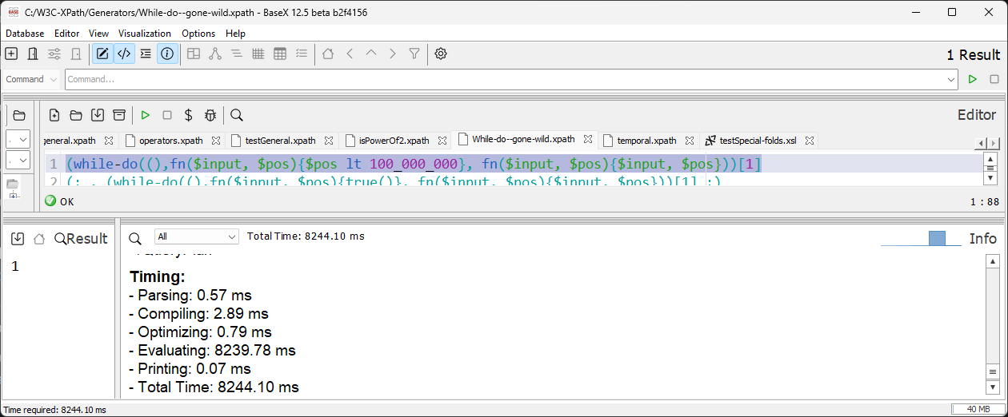

Slide 33
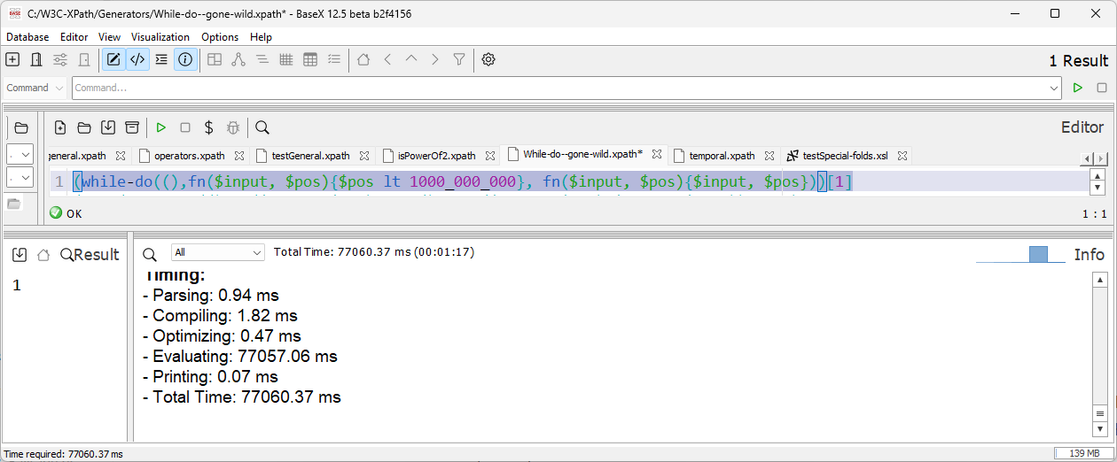

Slide 34
